Slide 1

UNIVERSITY INSTITUTE OF ENGINEERING
COMPUTER SCIENCE ENGINEERING
ARTIFICIAL INTELLIGENCE
(21CSH-611/621)
INTRODUCTION
DISCOVER . LEARN . EMPOWER

Slide 2
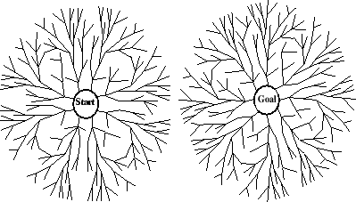
Bidirectional Search
Search forward from initial state to goal AND backward from goal state to initial state
Can prune many options
Considerations
Which goal state(s) to use
How determine when searches overlap
Which search to use for each direction
Here, two BFS searches
Time and space is O(b^{d/2})

Slide 3
Informed Searches
Best-first search, Hill climbing, Beam search, A*, IDA*, RBFS, SMA*
New terms
Heuristics
Optimal solution
Informedness
Hill climbing problems
Admissibility
New parameters
g(n) = estimated cost from initial state to state n
h(n) = estimated cost (distance) from state n to closest goal
h(n) is our heuristic
Robot path planning, h(n) could be Euclidean distance
8 puzzle, h(n) could be #tiles out of place
Search algorithms which use h(n) to guide search are heuristic search algorithms

Slide 4
Best-First Search
QueueingFn is sort-by-h
Best-first search only as good as heuristic
Example heuristic for 8 puzzle: Manhattan Distance

Slide 5
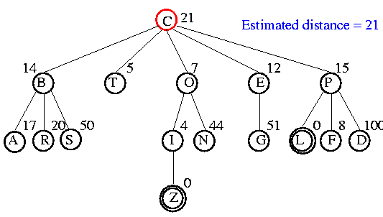
Example

Slide 6
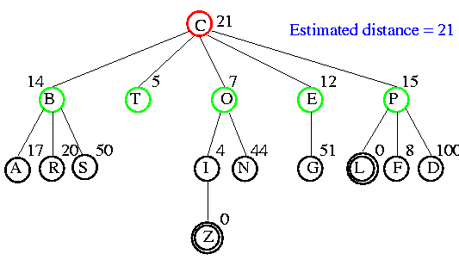
Example

Slide 7
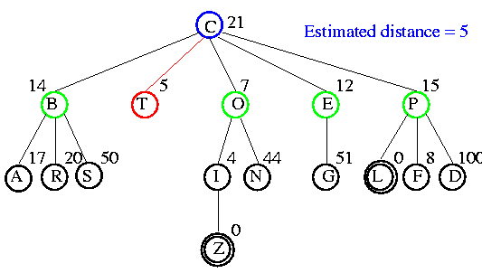
Example

Slide 8
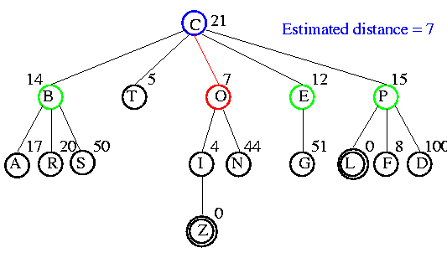
Example

Slide 9
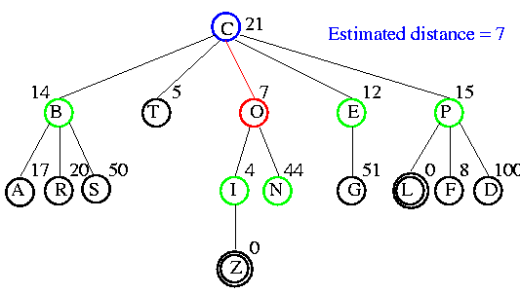
Example

Slide 10
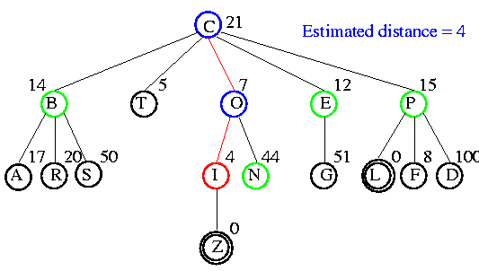
Example

Slide 11
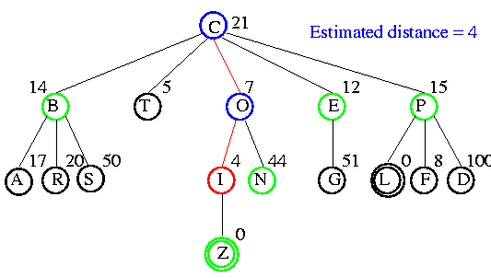
Example

Slide 12
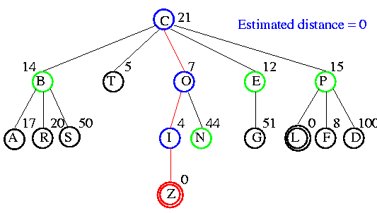
Example

Slide 13
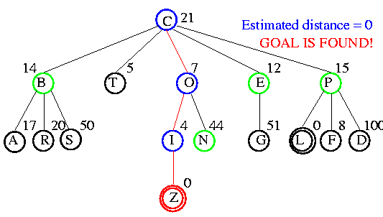
Example

Slide 14
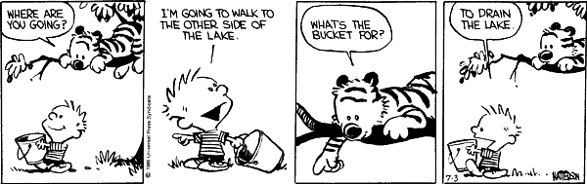
Comparison of Search Techniques
 | DFS | BFS | UCS | IDS | Best
Complete | N | Y | Y | Y | N
Optimal | N | N | Y | N | N
Heuristic | N | N | N | N | Y
Time | b^{m} | b^{d+1} | b^{m} | b^{d} | b^{m}
Space | bm | b^{d+1} | b^{m} | bd | b^{m}

Slide 15
Hill Climbing (Greedy Search)
QueueingFn is sort-by-h
Only keep lowest-h state on open list
Best-first search is tentative
Hill climbing is irrevocable
Features
Much faster
Less memory
Dependent upon h(n)
If bad h(n), may prune away all goals
Not complete

Slide 16
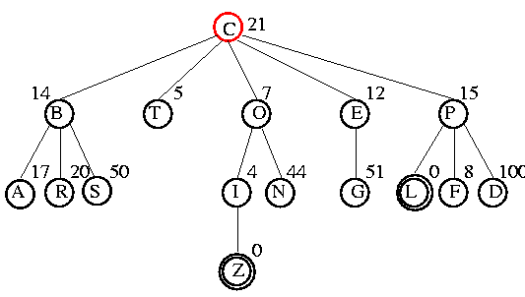
Example

Slide 17
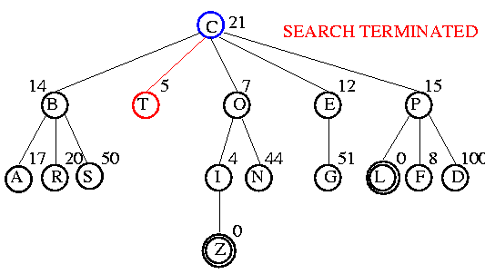
Example

Slide 18
Hill Climbing Issues
Also referred to as gradient descent
Foothill problem / local maxima / local minima
Can be solved with random walk or more steps
Other problems: ridges, plateaus
global maxima
local maxima

Slide 19
Comparison of Search Techniques
 | DFS | BFS | UCS | IDS | Best | HC
Complete | N | Y | Y | Y | N | N
Optimal | N | N | Y | N | N | N
Heuristic | N | N | N | N | Y | Y
Time | b^{m} | b^{d+1} | b^{m} | b^{d} | b^{m} | mn
Space | bm | b^{d+1} | b^{m} | bd | b^{m} | b

Slide 20
A*
QueueingFn is sort-by-f
f(n) = g(n) + h(n)
Note that UCS and Best-first both improve search
UCS keeps solution cost low
Best-first helps find solution quickly
A* combines these approaches

Slide 21
Power of f
If heuristic function is wrong it either
overestimates (guesses too high)
underestimates (guesses too low)
Overestimating is worse than underestimating
A* returns optimal solution if h(n) is admissible
heuristic function is admissible if never overestimates true cost to nearest goal
if search finds optimal solution using admissible heuristic, the search is admissible

Slide 22
Overestimating
A (15)
3
3
2
B (6)
C (20)
D (10)
15
6
20
10
5
E (20)
F(0)
G (12)
H (20)
I(0)
Solution cost:
ABF = 9
ADI = 8
Open list:
A (15) B (9) F (9)
Missed optimal solution

Slide 23
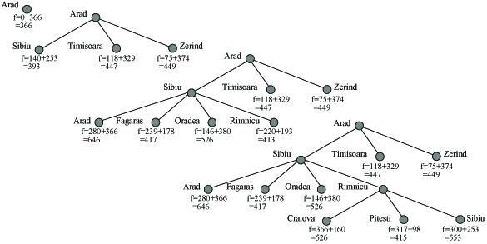
Example
A* applied to 8 puzzle
A* search applet

Slide 24
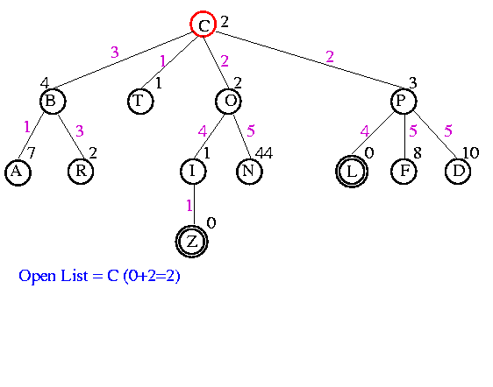
Example

Slide 25
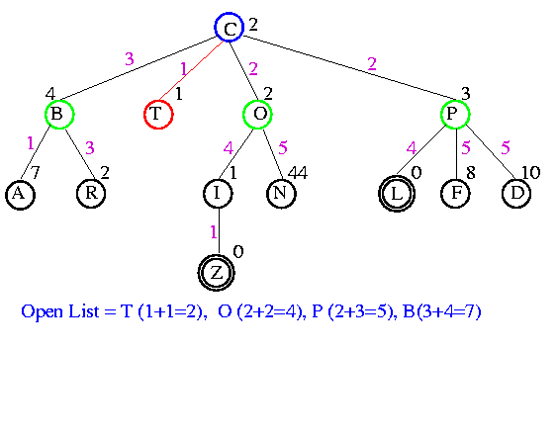
Example

Slide 26
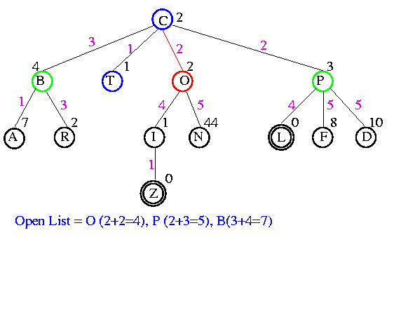
Example

Slide 27
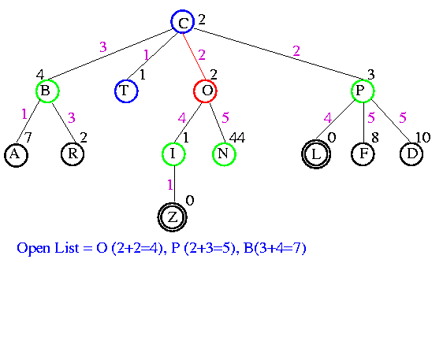
Example

Slide 28
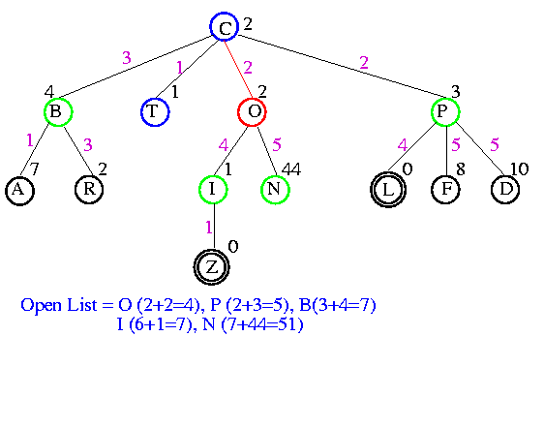
Example

Slide 29
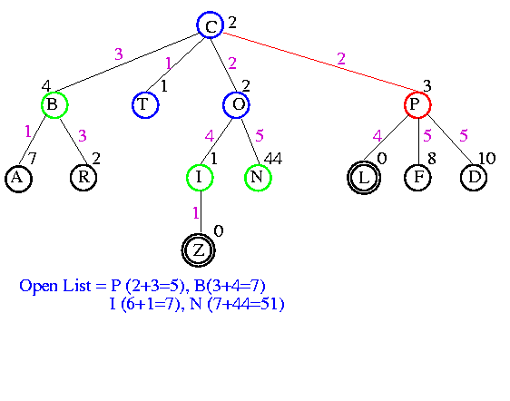
Example

Slide 30
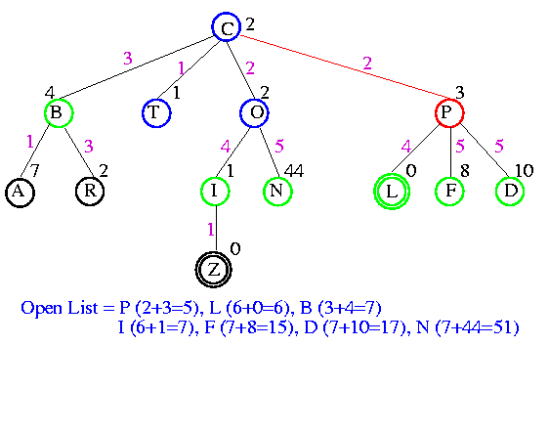
Example

Slide 31
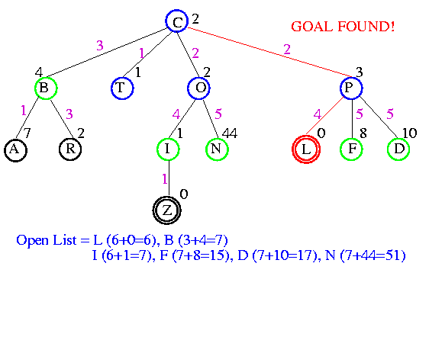
Example

Slide 32
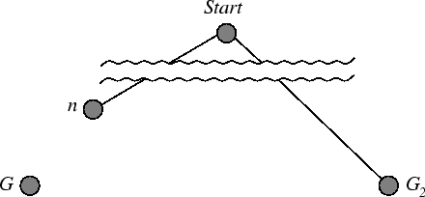
Optimality of A*
Suppose a suboptimal goal G₂ is on the open list
Let n be unexpanded node on smallest-cost path to optimal goal G₁
f(G₂) = g(G₂) since h(G₂) = 0
>= g(G₁) since G₂ is suboptimal
>= f(n) since h is admissible
Since f(G₂) > f(n), A* will never select G₂ for expansion

Slide 33
Comparison of Search Techniques
 | DFS | BFS | UCS | IDS | Best | HC | Beam | A*
Complete | N | Y | Y | Y | N | N | N | Y
Optimal | N | N | Y | N | N | N | N | Y
Heuristic | N | N | N | N | Y | Y | Y | Y
Time | b^{m} | b^{d+1} | b^{m} | b^{d} | b^{m} | bm | nm | b^{m}
Space | bm | b^{d+1} | b^{m} | bd | b^{m} | b | bn | b^{m}

Slide 34
THANK YOU

